Slide 1
LECTURE 1
Graph
Foundations
for GCNs
B
C
From graph theory and representations
to the ideas that make GCNs possible.
A
D
E
G = (V, E)

Slide 2
Course goals
What students should be able to do before the first GCN layer
1. Graph reasoning
2. Representation
3. GCN readiness
Define nodes, edges, neighborhoods, degree, paths, cycles, connectivity, trees, and sparsity.
Move confidently between graph drawings, adjacency matrices, adjacency lists, edge lists, and feature matrices.
Understand why ordinary CNNs do not transfer directly to irregular graphs and why message passing is the right abstraction.
4. Mathematics
5. Classroom habit
Use matrix multiplication, normalization, Laplacians, dimensions, and simple eigenvalue ideas.
Do not memorize the GCN equation first. Explain what each matrix does before writing the formula.

Slide 3
Prerequisites
START HERE
Only the pieces that the GCN pipeline actually needs
Programming + ML
Mathematics
Python: variables, loops, arrays, functions, classes
Basic neural networks: layers, activations, loss
Vectors and matrices; matrix multiplication
Derivatives, chain rule, gradient descent
Basic probability/statistics
Diagnostic question
Can a student explain why (n×d)(d×h) = n×h?
If not, spend one short review session on matrix shapes before GCNs.

Slide 4
1. What is a graph?
The central abstraction behind networked data
A graph is a mathematical structure for representing objects and the relationships between them.
Graphs are a general language for describing and
analyzing entities with relations/interactions
B
G = (V, E)
A
C
V — vertices / nodes
E — edges / links
Objects or entities
Examples: people, papers, atoms, road intersections
Relationships between nodes
Friendship, citation, road, chemical bond
D
E
n = |V| m = |E|

Slide 5
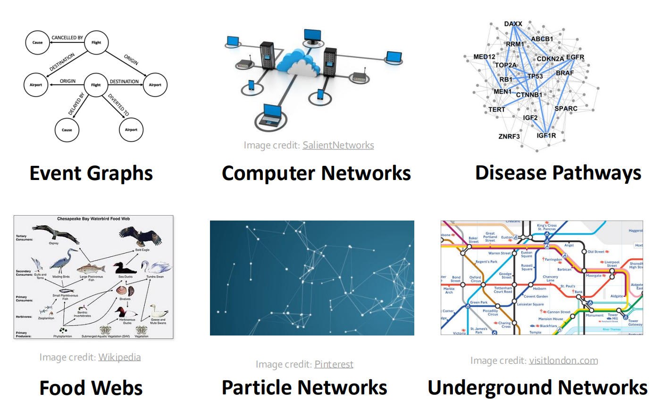
Many Types of Data are Graphs
E — edges / links

Slide 6
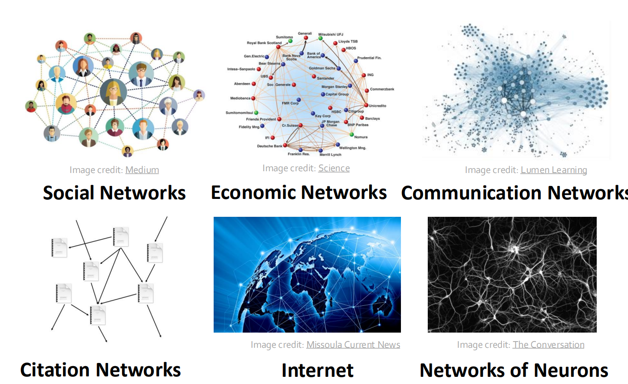
Many Types of Data are Graphs

Slide 7
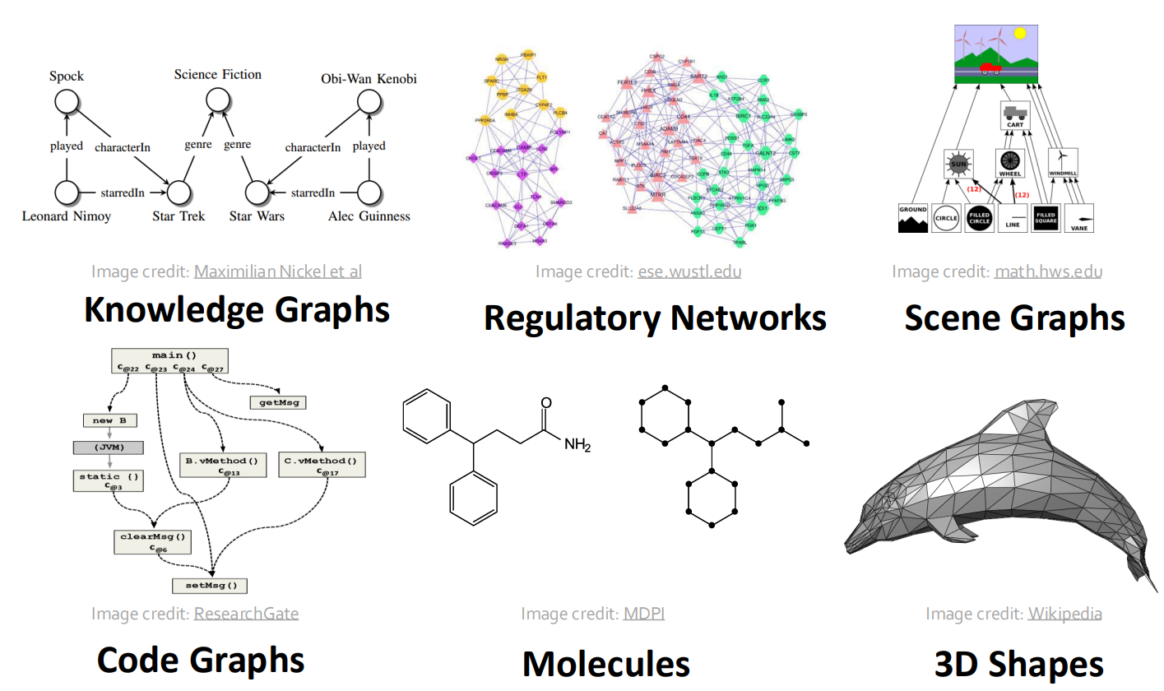
Many Types of Data are Graphs

Slide 8
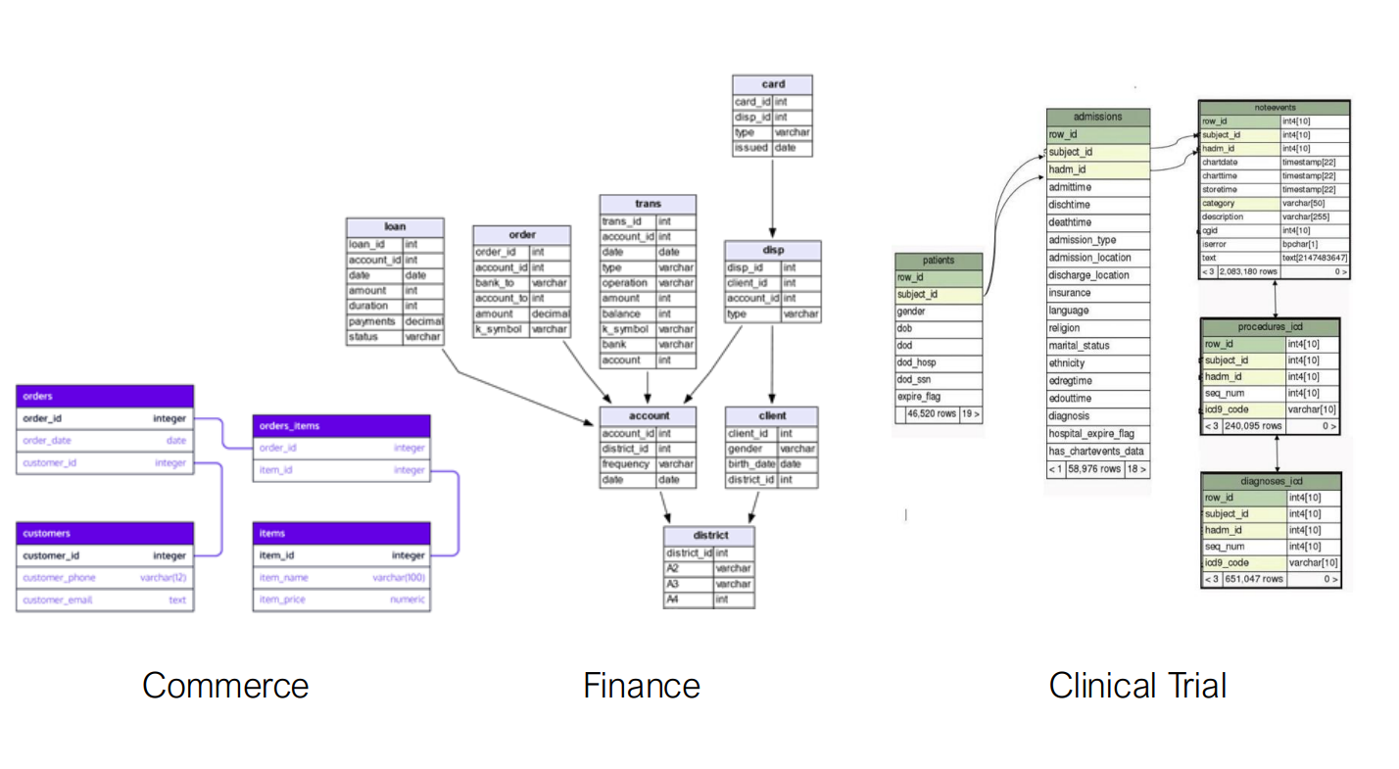
Databases are Graphs

Slide 9
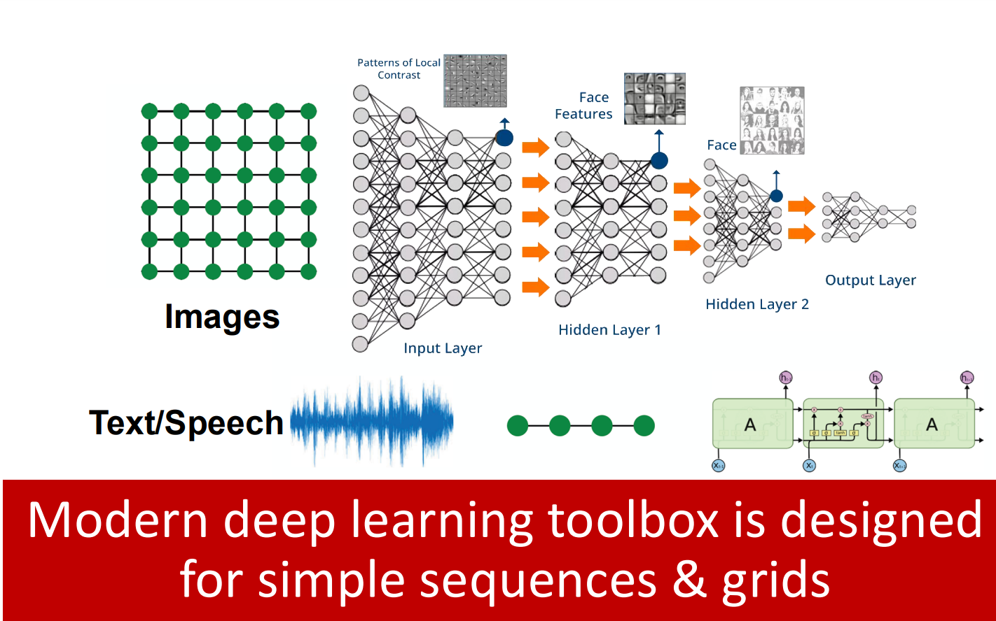
Graphs in the Machine Learning
Complex domains have a rich relational structure, which can be represented as a relational graph. By explicitly modeling relationships we achieve better performance!

Slide 10
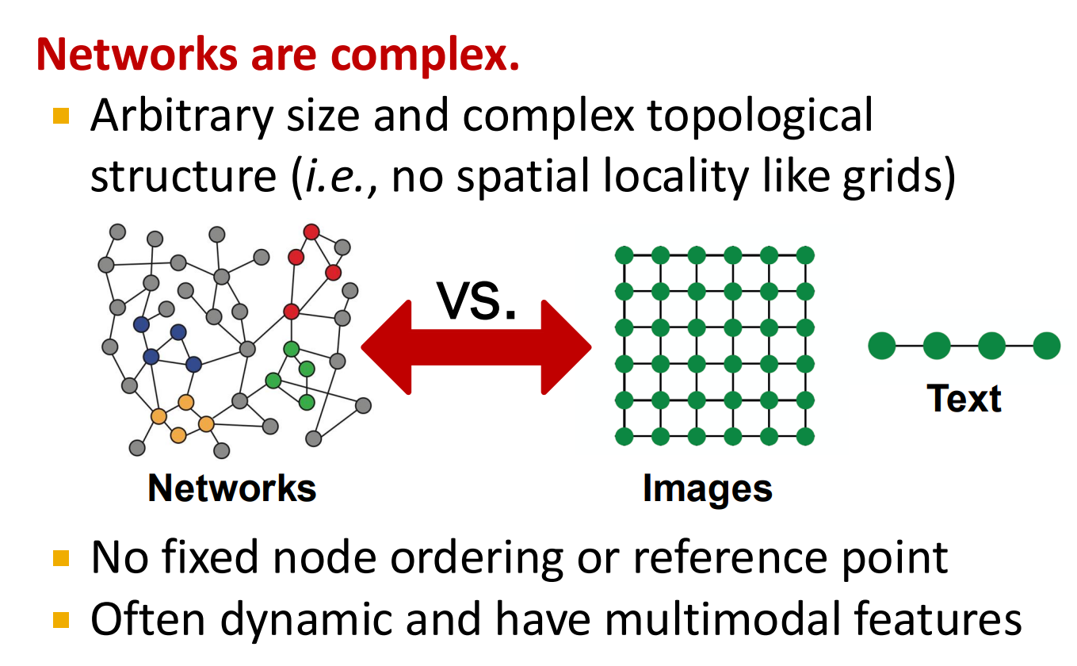
Why is Graph Deep Learning is Hard?
How can we develop neural networks that are much more broadly applicable?
Graphs are the new frontier of deep learning

Slide 11
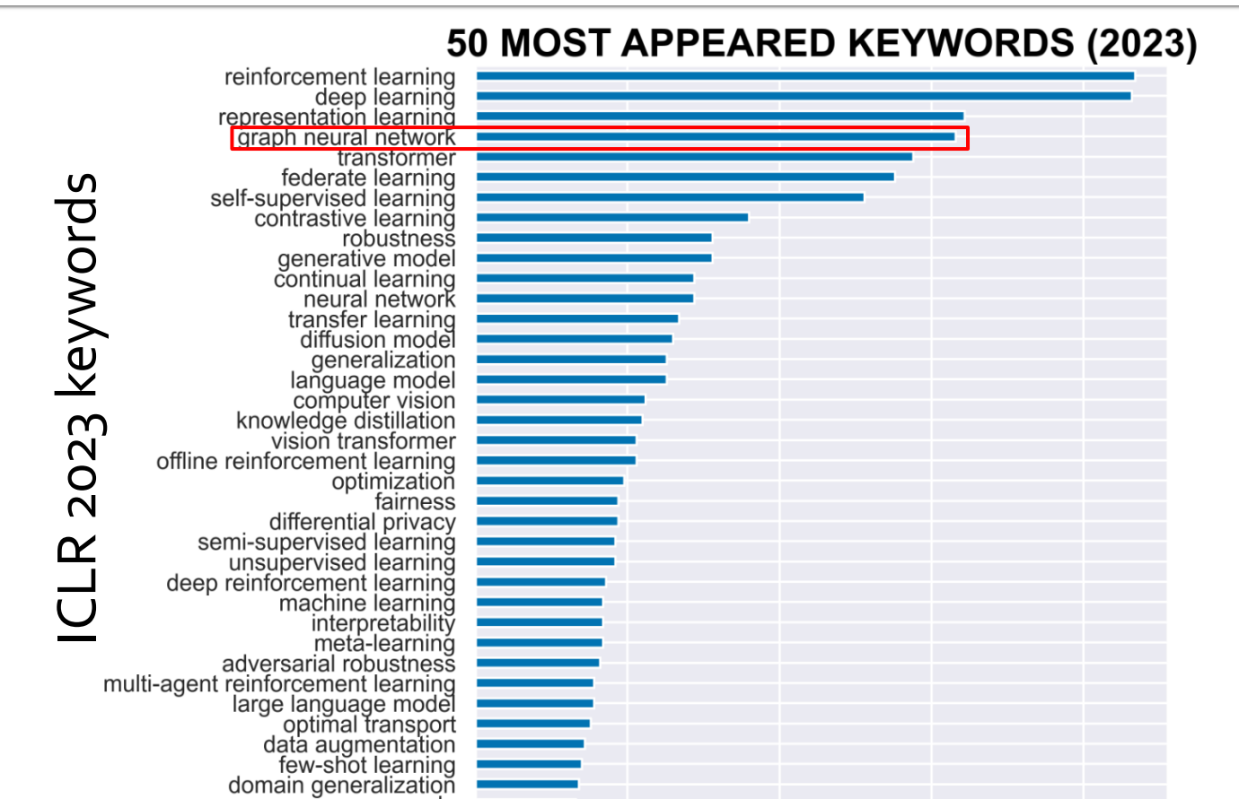
Graph Neural Networks in Research Community
How can we develop neural networks that are much more broadly applicable?
Graphs are the new frontier of deep learning

Slide 12
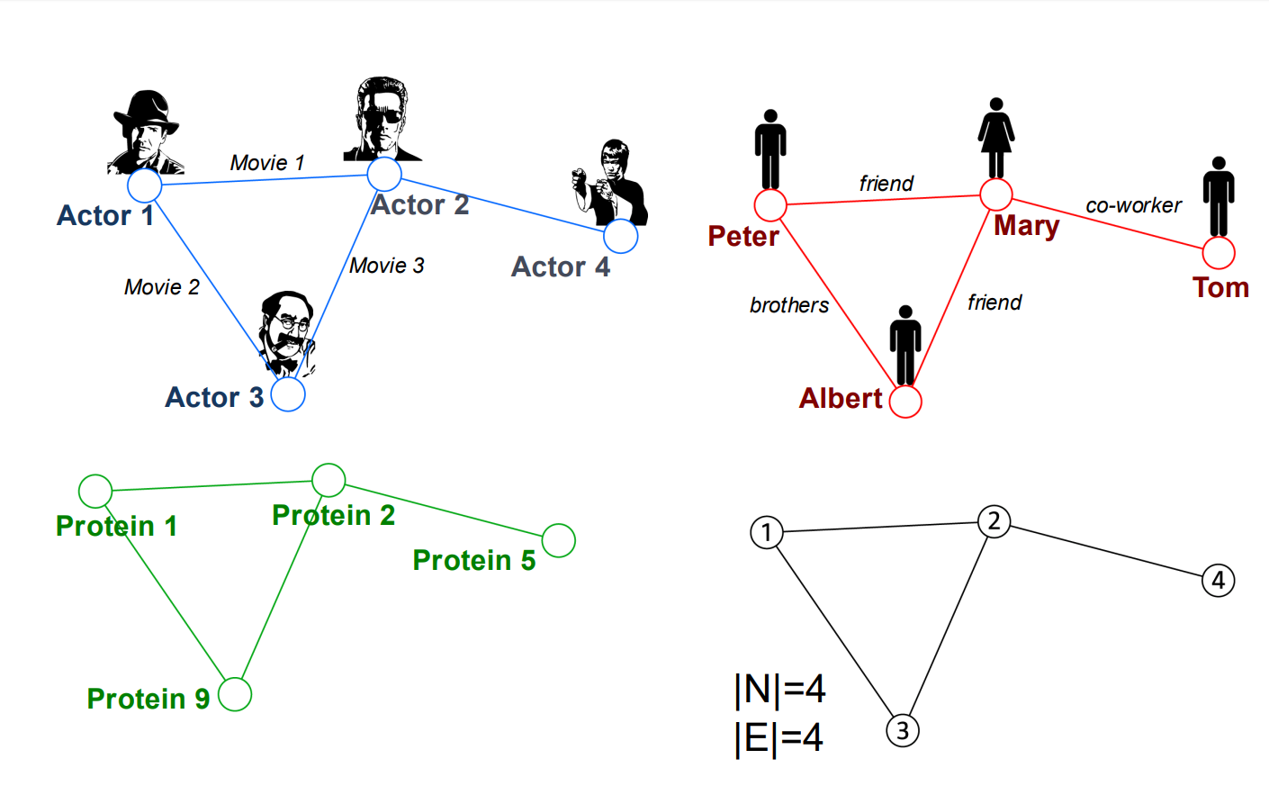
Common Language in Graphs

Slide 13
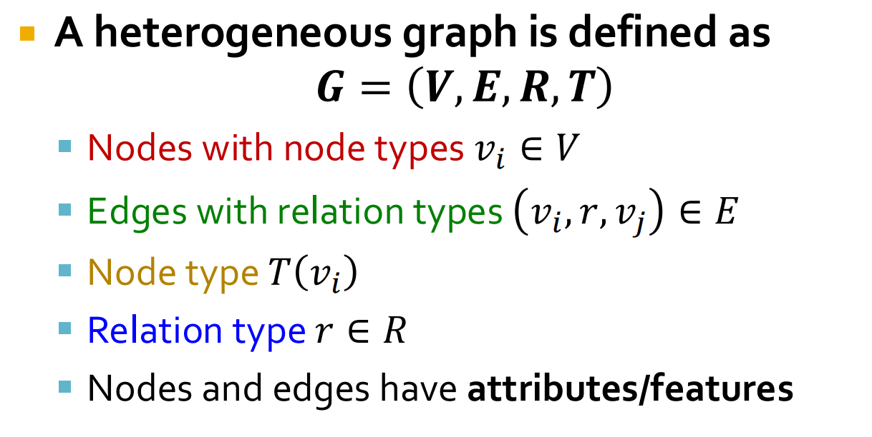
Heterogeneous Graphs

Slide 14
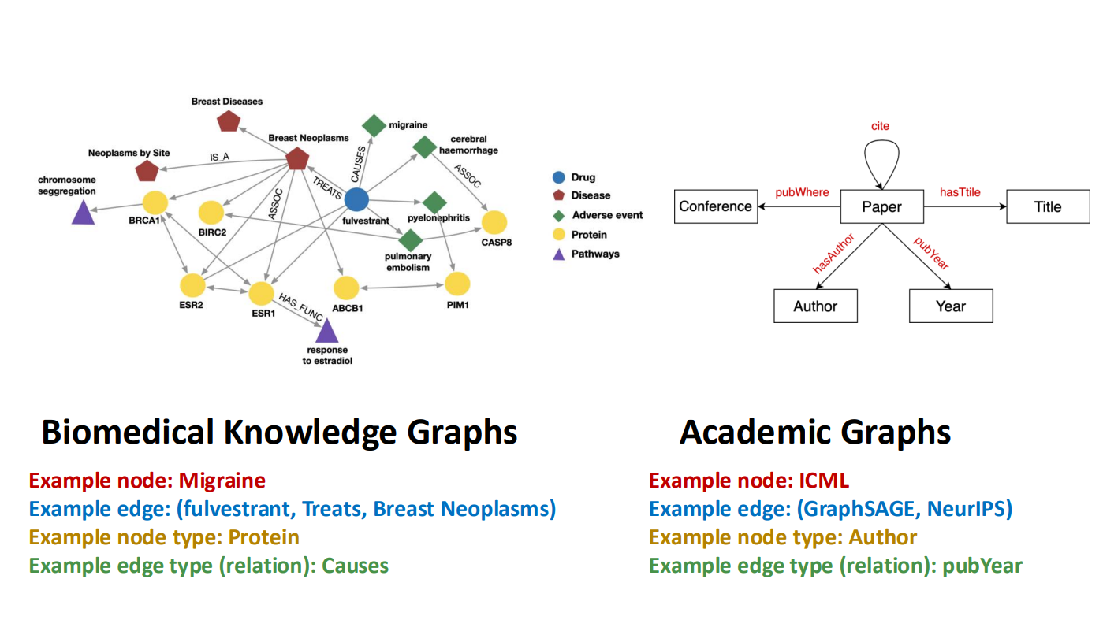
Hetrogenious Graphs

Slide 15
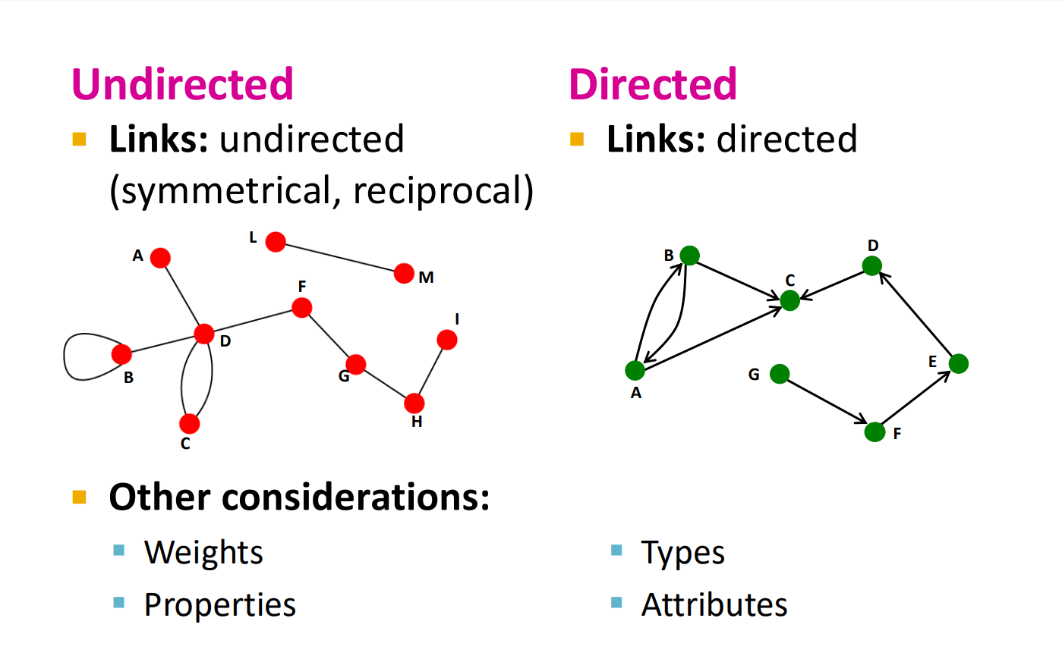
Directed VS Undirected Graphs

Slide 16
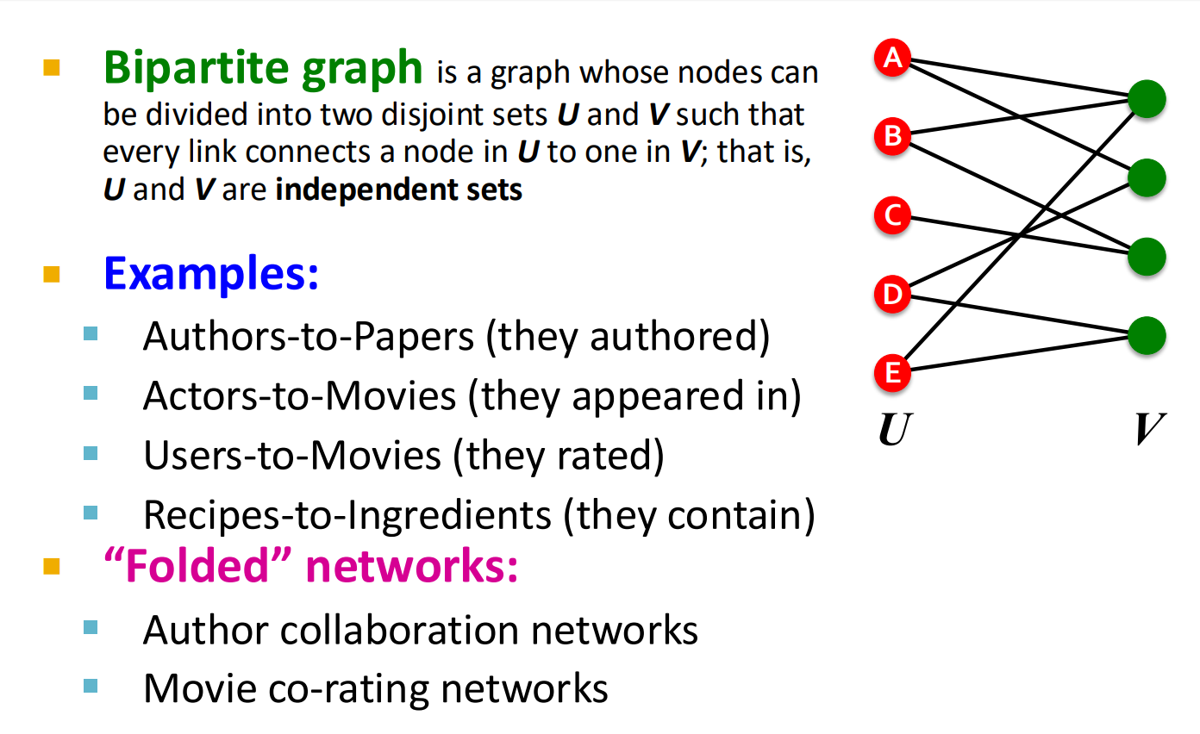
Bipartite Graphs

Slide 17
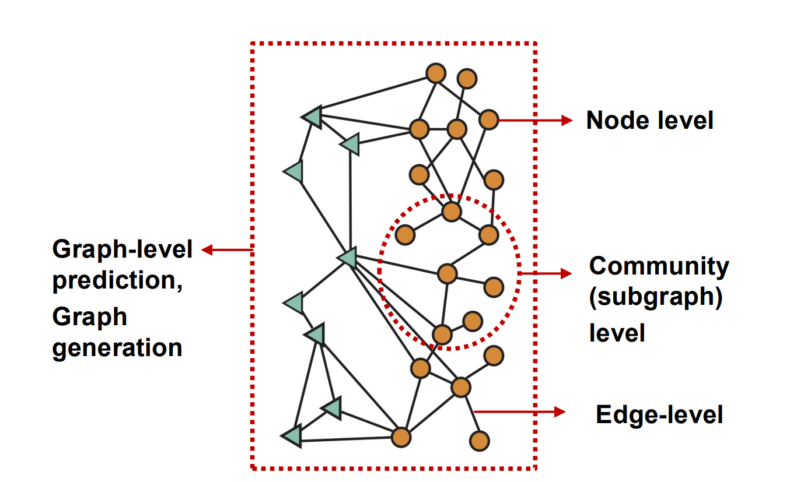
Different Types of Tasks

Slide 18
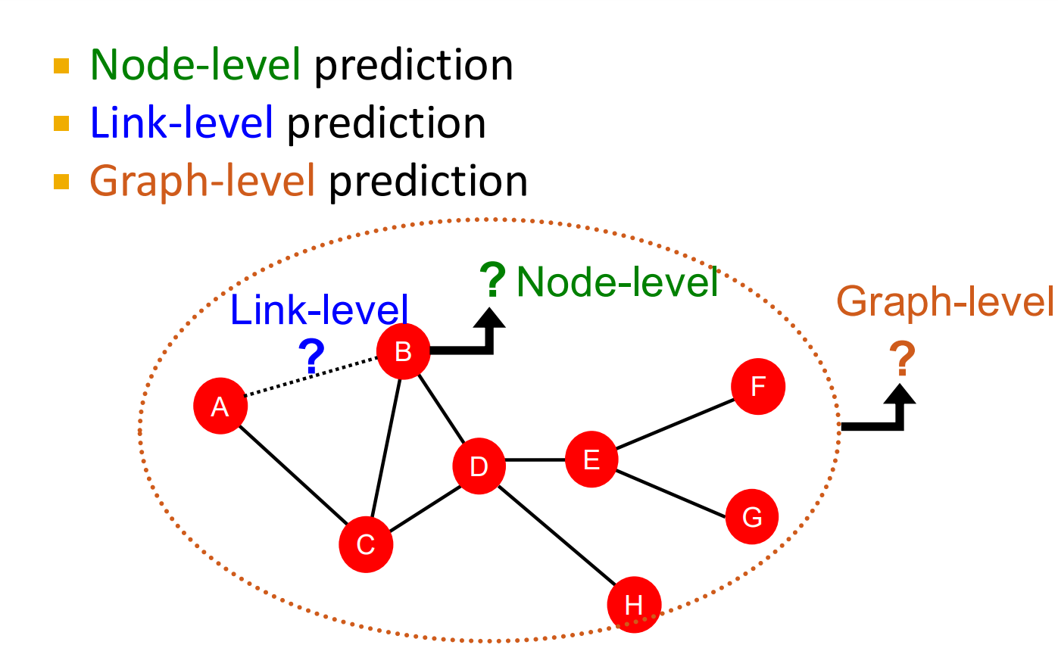
ML / DL Types of Tasks

Slide 19
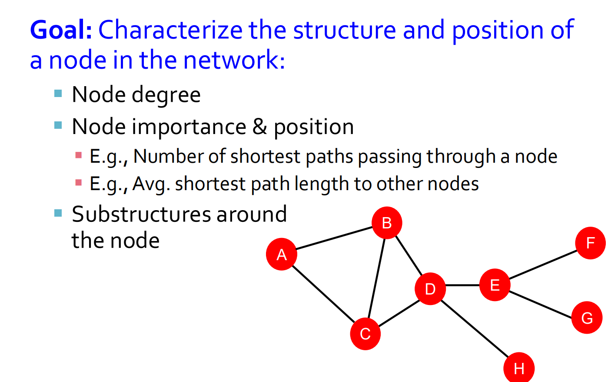
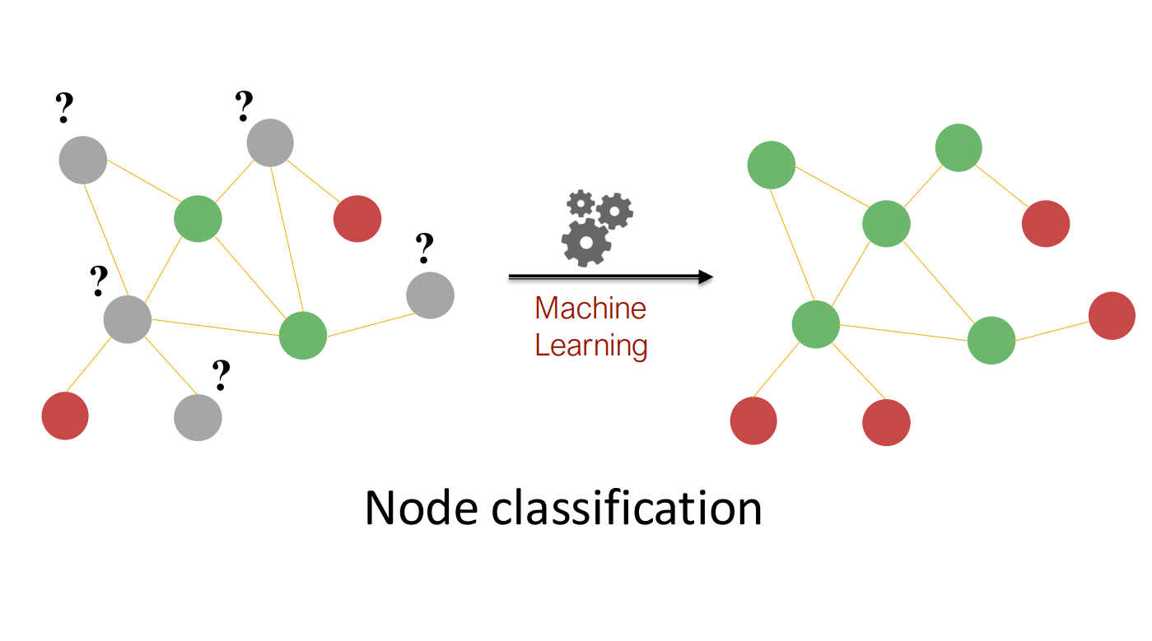
Node Level Classification

Slide 20
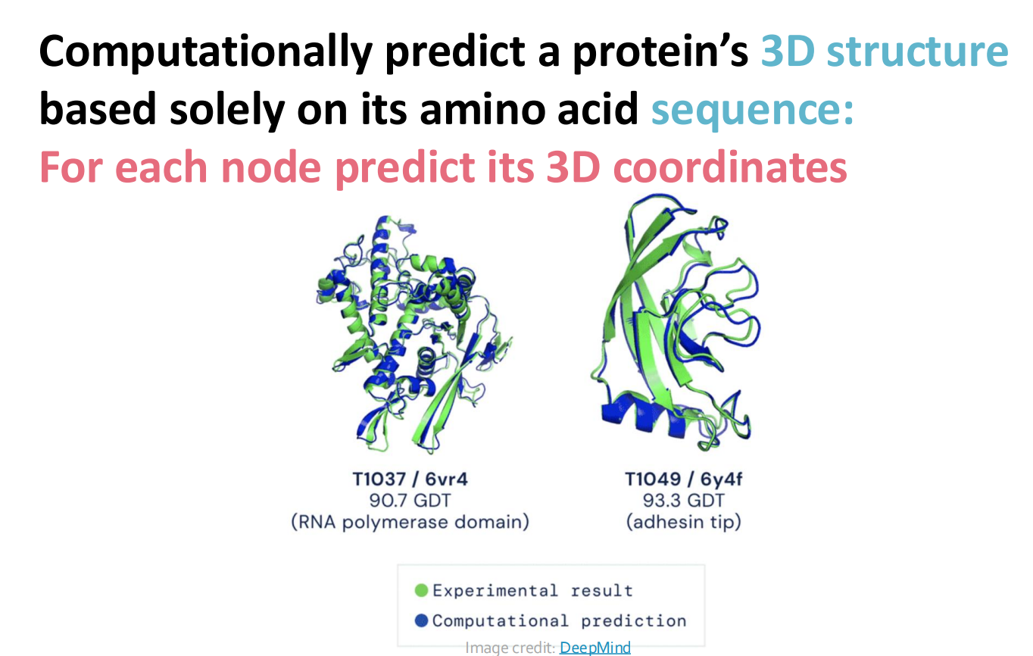
Protien Folding

Slide 21
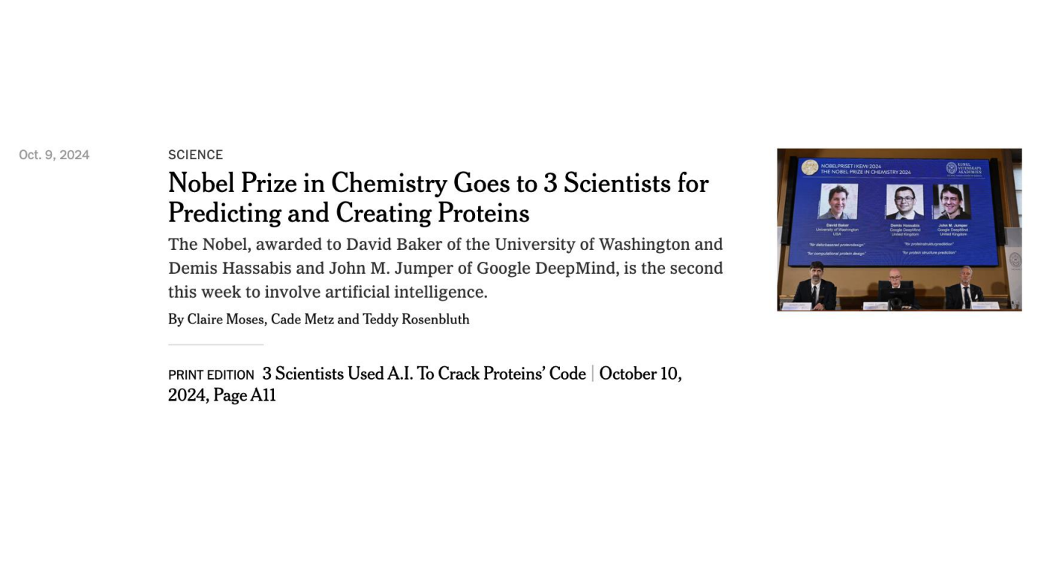
Protien Folding

Slide 22
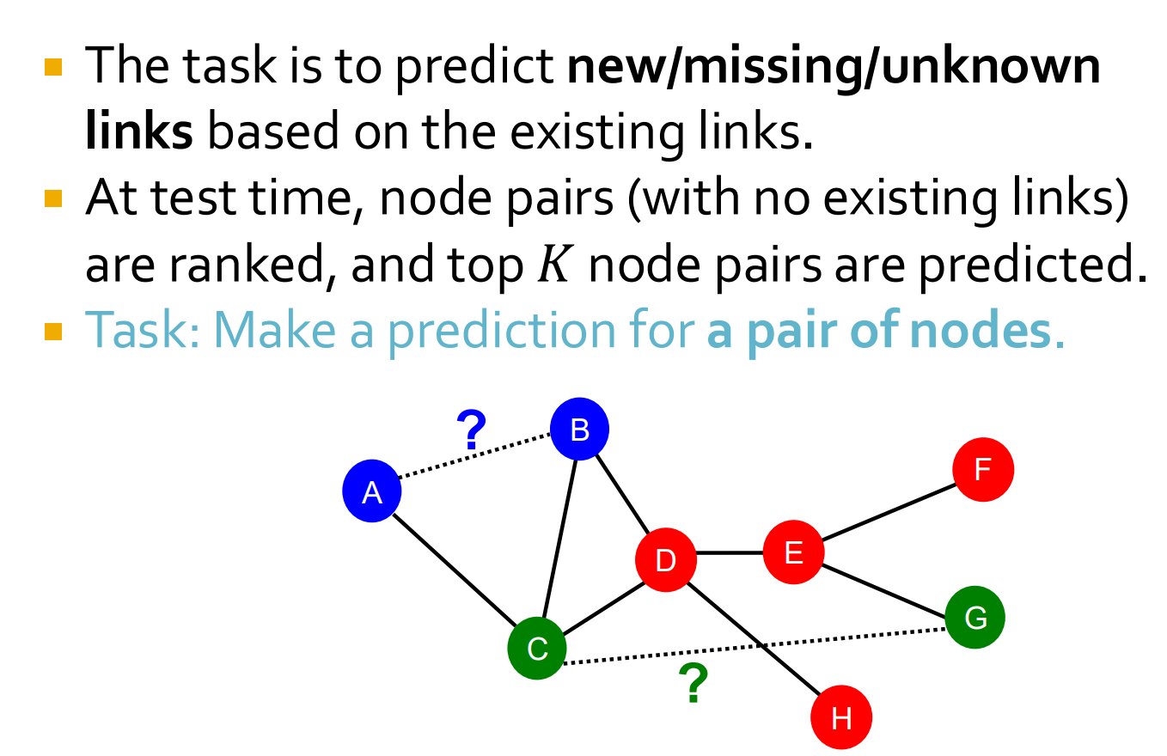
Link Level Predictions

Slide 23
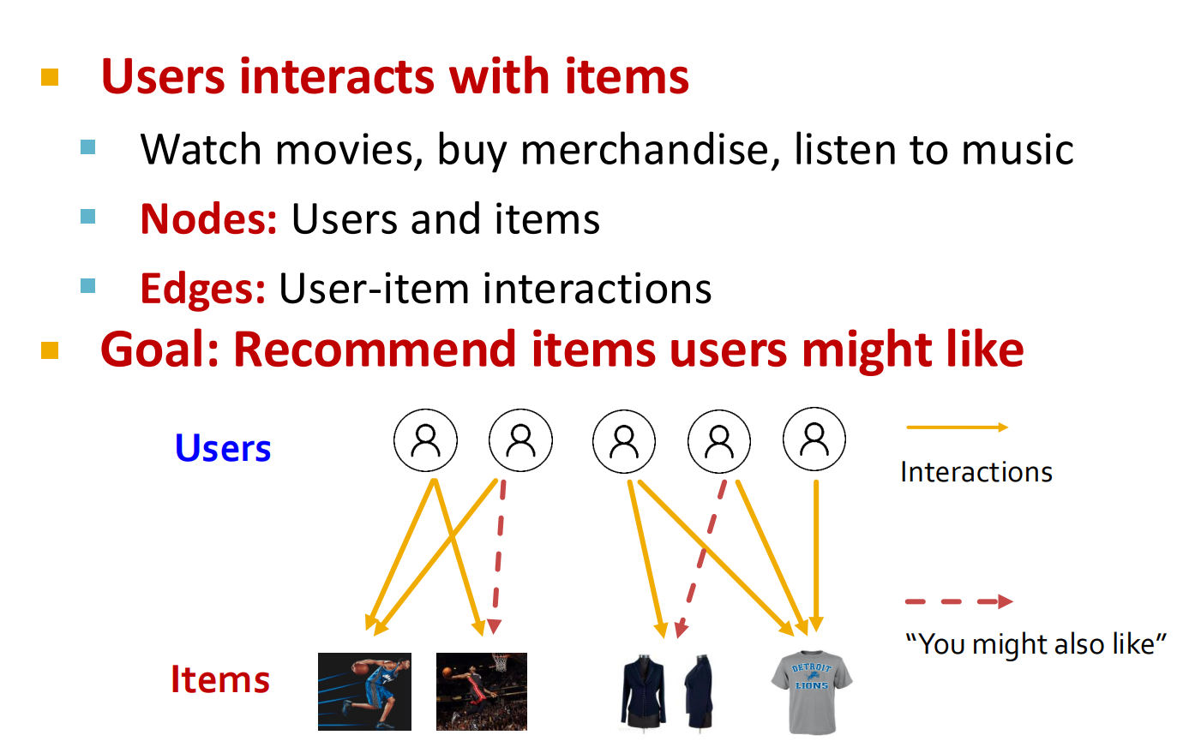
Recommended Systems

Slide 24
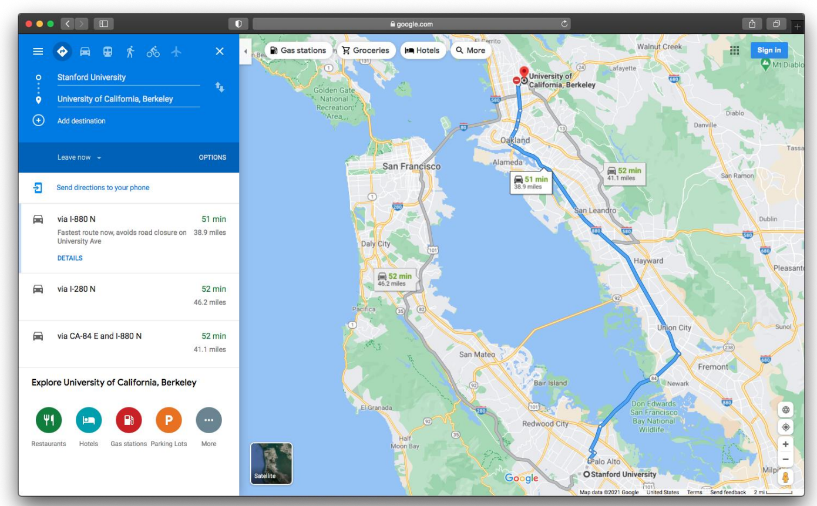
Recommended Systems
Goal: We want make a prediction for an entire graph or a subgraph of the graph.

Slide 25
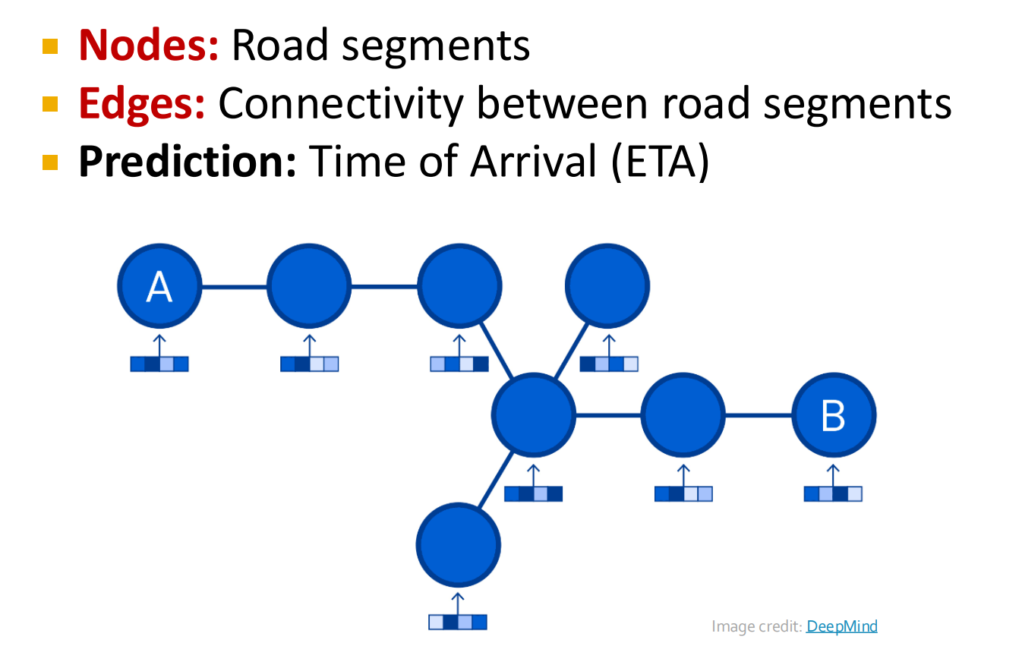
Road Network as a Graph

Slide 26
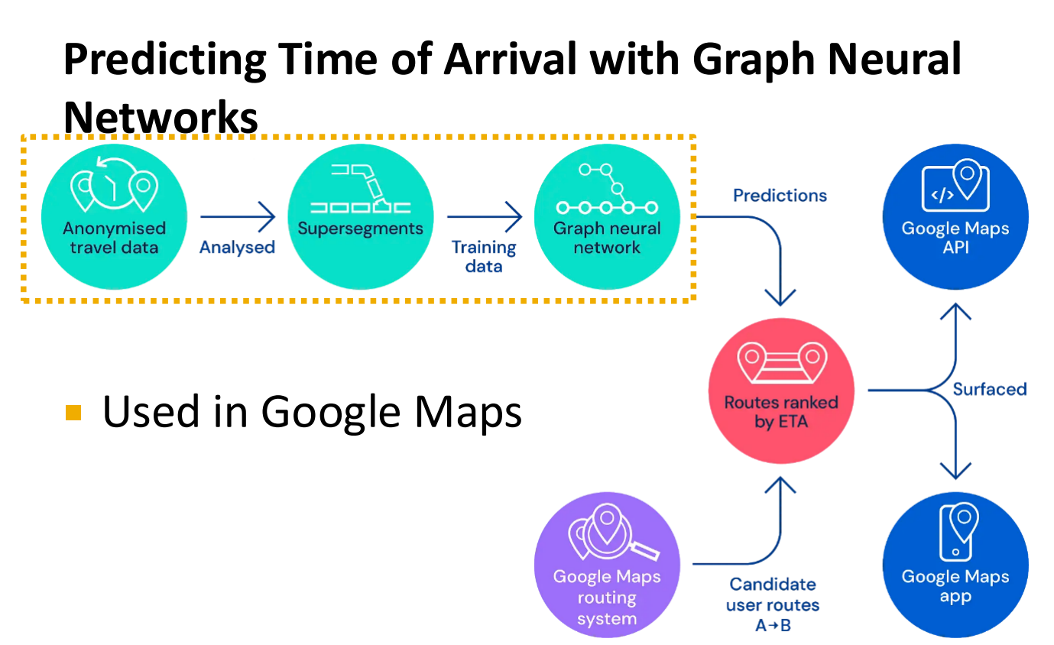
Traffic Prediction Via GCN

Slide 27
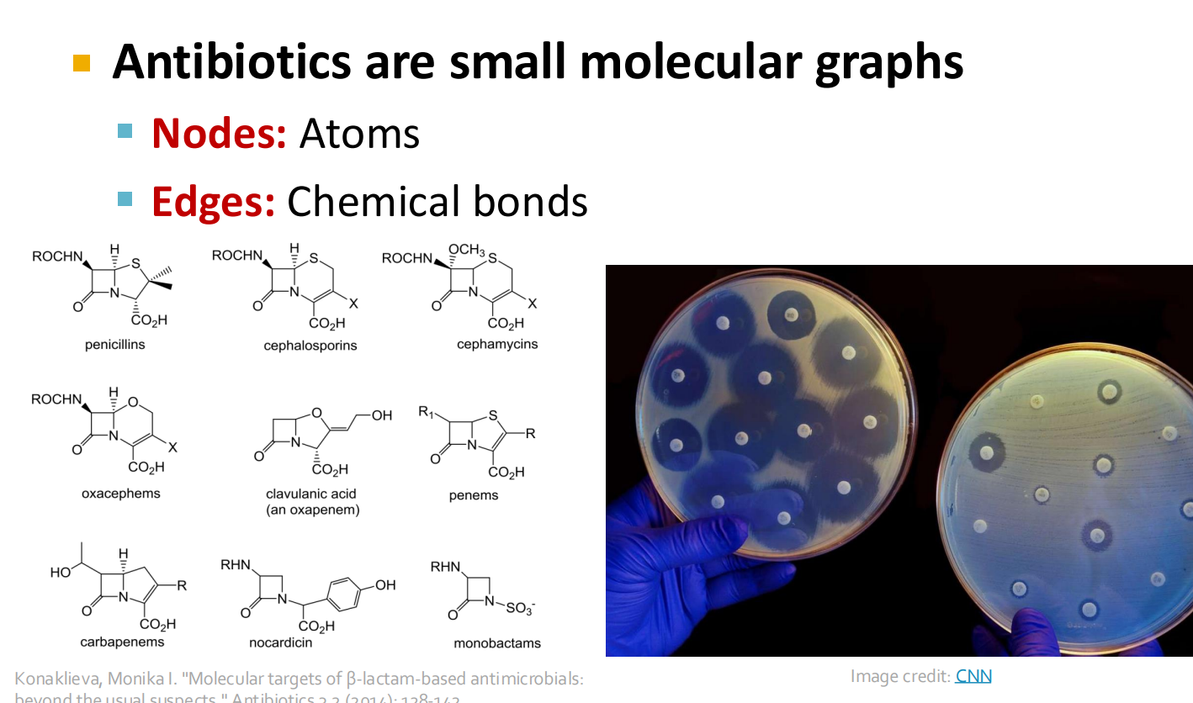
Drug Discovery Via GCN

Slide 28
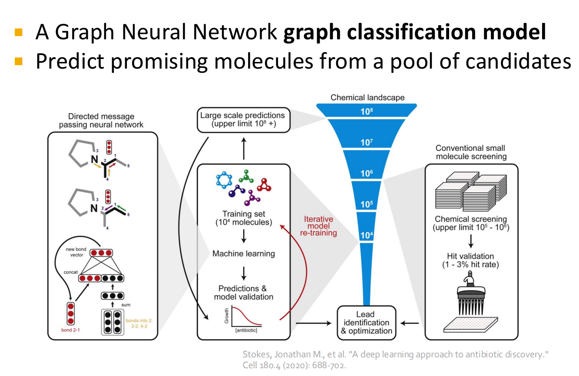
Deep Learning for Antibiotic Discovery

Slide 29
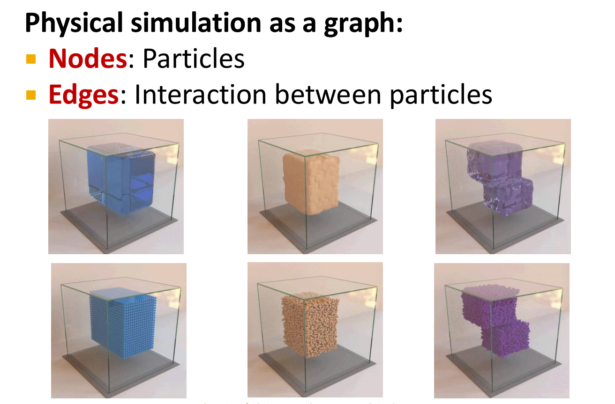
Physics Simulation

Slide 30
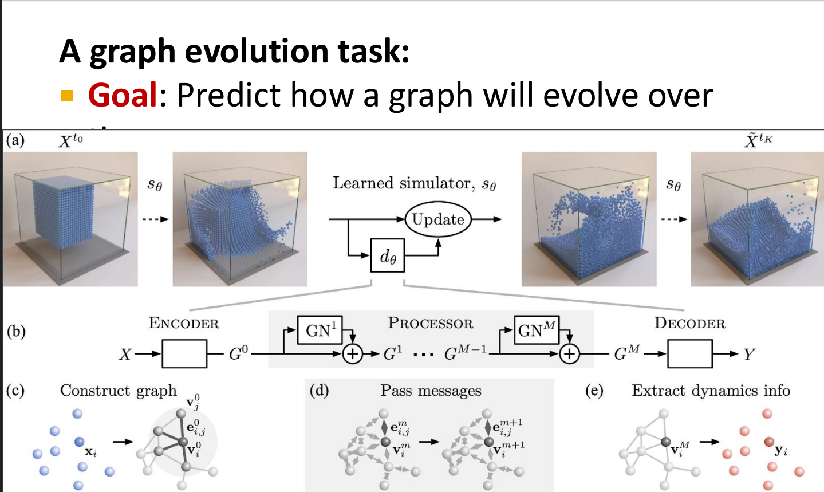
Simulation Learning Framework

Slide 31
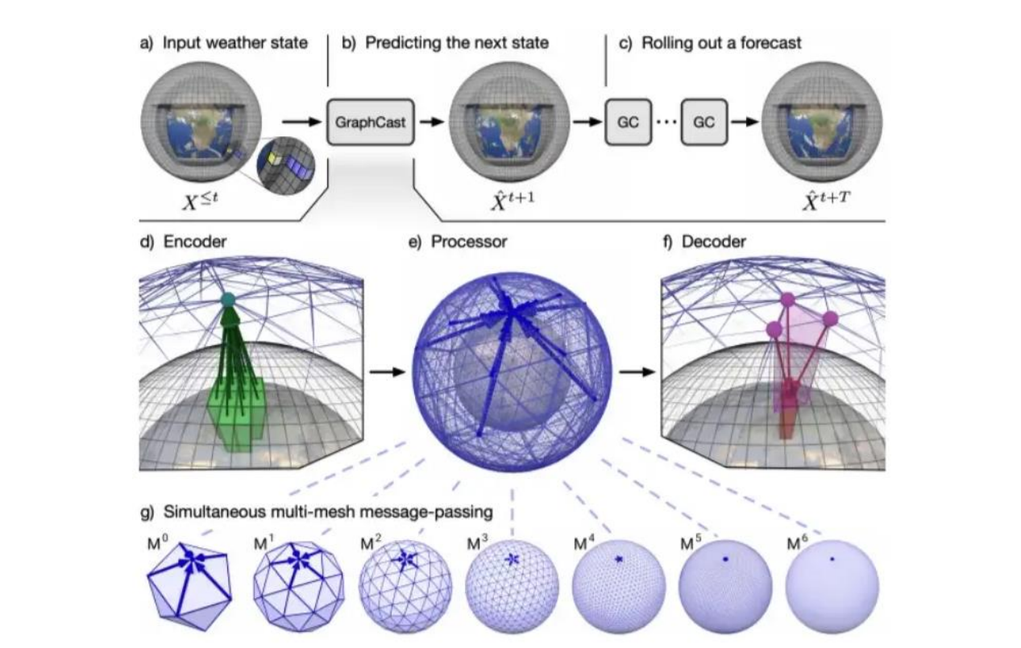
Weather Prediction

Slide 32
2. Common graph variants
The GCN idea starts simple, then generalizes
Type | Meaning | Example
Undirected | u—v means the same relationship as v—u | Friendship
Directed | u→v differs from v→u | Citation / follow
Weighted | Edges carry values | Distance / similarity
Simple | No self-loops or parallel edges | Basic teaching graph
Sparse | m ≪ n² | Large real-world networks
Teaching default: begin with an undirected, unweighted graph, then add weights and direction when the students are comfortable.

Slide 33
3. Why graphs appear everywhere
Same abstraction, very different meanings
Social network
Web / citation
Road network
People → nodes
Friendships → edges
Pages or papers → nodes
Links/citations → directed edges
Intersections → nodes
Roads → edges
Molecule
Recommendation
Image regions
Atoms → nodes
Bonds → edges
Users/items → nodes
Interactions → edges
Patches/pixels → nodes
Spatial relations → edges
A key teaching point: the graph structure changes, but the mathematical language stays the same.

Slide 34
Examples worth discussing in class
Use the examples to motivate scale, structure, and graph algorithms
Karate Club
Web graph
34 vertices and 78 friendship edges. A small but visual example for neighborhoods, degree, and communities.
Web pages become vertices; hyperlinks become directed edges. The important lesson is that graphs can be enormous and dynamic.
Street map
Compiler register allocation
Intersections are vertices; streets are edges. Shortest path becomes a natural graph problem.
Variables become vertices; an edge means two variables interfere. Coloring the graph models register assignment.

Slide 35
4. Important terminology: edges and adjacency
These words must become automatic before matrix notation
e = {u, v}
Vocabulary
Endpoints of e: u and v
Adjacent nodes: u and v
Incident edge: e is incident on u and v
Neighbor: v is a neighbor of u
Path: sequence of adjacent nodes
Shortest-path distance: minimum number of edges
Connected component: maximal mutually reachable set
v
u
w
z

Slide 36
5. Neighborhood and degree
The first quantities a GCN will aggregate over
Definitions
For u ∈ V:
N(u) = {v : {u,v} ∈ E}
deg(u) = |N(u)| for an undirected graph
Closed neighborhood: N[u] = N(u) ∪ {u}
Self-loops make the closed neighborhood participate in GCN aggregation.
y
x
v
w
z
N(y) = {v, w, z}
deg(y) = |N(y)| = 3

Slide 37
6. How many edges can a graph have?
A useful counting result for understanding sparse graphs
For a simple undirected graph with n vertices, every edge chooses 2 distinct endpoints.
m ≤ n(n − 1) / 2
Example: n = 5
Example: n = 1,000
Why it matters
Maximum edges = 5×4/2 = 10
Maximum edges = 499,500
An n×n dense matrix stores O(n²) entries even if only a small fraction are edges.
This is the motivation for sparse graph storage and sparse message passing.

Slide 38
7. Directed graphs: in-degree and out-degree
Direction changes what “neighbor” means
Definitions
out-degree(u): number of edges leaving u
in-degree(u): number of edges entering u
In a directed graph, u → v and v → u are different relationships.
For GCN teaching, begin with undirected graphs so aggregation is easier to visualize, then explain how frameworks represent both directions for message passing.
B
A
C
E
D

Slide 39
8. Paths
A path is a sequence of adjacent vertices
Teaching points
A path is a sequence of vertices with consecutive vertices adjacent.
Length = number of edges used.
Shortest path = minimum possible path length between two vertices.
B
D
A
E
C
Highlighted path: A → B → C → D → E

Slide 40
9. Shortest-path distance
Distance on a graph is not Euclidean distance
Why GCN students need it
A 1-layer GCN sees at most 1-hop neighbors.
A 2-layer GCN can incorporate information up to roughly 2 hops away.
Depth therefore controls the receptive field.
B
D
A
C
E
dist(A,E) = 2 via A → C → E

Slide 41
10. Cycles
A cycle starts and ends at the same vertex without repeating vertices internally
Why cycles matter
B
C
Trees have no cycles.
Cycles increase structural complexity and often create multiple routes between nodes.
Many graph algorithms and message-passing patterns behave differently on trees and cyclic graphs.
A
D
F
E
A → B → C → D → E → F → A

Slide 42
11. Connected components
A GCN cannot communicate across a missing connection
B
F
A
C
E
G
D
Component 1
Component 2
No message passes from one component to the other unless a new edge is added.

Slide 43
Sparse graph
12. Density, sparsity, and scale
A sparse graph is a graph in which the number of edges is much smaller than the maximum possible number of edges. In simple terms, it is a graph where most potential connections between nodes do not actually exist.
Why sparse graph computation is essential
Dense graph
Key idea
1
2
3
4
2
4
5
6
7
8
A large graph may have millions of nodes but only a few edges per node.
GCN frameworks therefore favor sparse edge storage and sparse message passing.
1
3
5
9
10
11
12
m ≈ O(n²)
6
A dense graph is a graph in which the number of edges is close to the maximum possible number of edges. In simple terms, it is a graph where most nodes are connected to most other nodes.
m ≪ n²

Slide 44
13. Adjacency matrix
A matrix whose nonzero entries encode graph connectivity
0
1
0
0
1
For undirected graphs
2
3
A = Aᵀ
The matrix is symmetric.
The diagonal is 0 for a simple graph before self-loops are added.
1
0
1
0
1
0
1
0
1
0
1
4
0
0
1
0
1
1
1
0
1
0
5
Aᵢⱼ = 1 if i and j are connected
Aᵢⱼ = 0 otherwise
An adjacency matrix is a square matrix used to represent a finite graph. The elements of the matrix indicate whether pairs of vertices are adjacent or not in the graph.

Slide 45
14. Adjacency list
Store only the neighbors that actually exist
Example graph
A: B, D
A — B — C
| | /
D — E — F
B: A, C, E
C: B, E, F
D: A, E
E: B, C, D, F
F: C, E
Storage ≈ O(n + m) for a sparse graph
This is much smaller than O(n²) when m ≪ n².
An adjacency list is a collection of unordered lists used to represent a finite graph. Each list describes the set of neighbors of a vertex in the graph.

Slide 46
15. Adjacency matrix vs adjacency list
Students should know both before using PyG edge_index
Representation | Storage | Best mental model | Typical use
Adjacency matrix | O(n²) | “Is i connected to j?” | Tiny/dense graphs
Adjacency list | O(n+m) | “Who are i’s neighbors?” | Sparse graphs
Edge list / edge_index | O(m) | “Here are the edges.” | Sparse GNN libraries
GCN connection
A GCN layer can be understood as sparse neighborhood aggregation over edge_index instead of multiplying a huge dense n×n matrix.

Slide 47
16. Trees
A tree is connected and contains no cycles
Key tree facts
A
For a tree with n vertices:
• exactly n − 1 edges
• exactly one simple path between any two vertices
• removing any edge disconnects the graph
Trees are ideal teaching examples for recursive graph algorithms and message passing.
B
C
D
E
F
G

Slide 48
17. Regular graphs
A graph where every vertex has the same degree
Why mention regularity?
Degree is one of the first structural statistics students can calculate.
Regular graphs also make normalization easy to reason about because all nodes have the same local degree.
Later, students should compare this with graphs containing hubs and highly uneven degrees.
B
C
A
D
F
E
Every node has degree 2

Slide 49
18. Complete graphs and graph families
Useful reference structures for exercises
Useful families
Complete graph Kₙ: every pair is adjacent.
Cycle graph Cₙ: vertices form one cycle.
Path graph Pₙ: vertices form one chain.
Tree: connected, no cycles.
These families make good hand-calculation exercises for A, D, and L.
1
2
4
3
K₄: every pair of vertices is connected

Slide 50
19. Graph algorithms preview
Graph data structures are not only for neural networks
BFS
DFS
Dijkstra
Max-Cut
Breadth-first search
Shortest paths in unweighted graphs
Depth-first search
Connectivity, components, traversal
Weighted shortest path
Shortest paths with nonnegative weights
Partition vertices
Cut as many edges as possible
Teaching bridge to GCNs: classical graph algorithms reason over structure; GNNs learn representations by repeatedly aggregating over that structure.

Slide 51
20. BFS: breadth-first search
Explore neighbors layer by layer
Core idea
1
1. Start from a source.
2. Visit all current neighbors.
3. Move outward one level at a time.
4. Keep a queue of discovered vertices.
For an unweighted graph, BFS discovers shortest-path distance from the source.
B
3
C
0
A
5
E
2
D
4
F

Slide 52
21. DFS: depth-first search
Follow one branch as far as possible before backtracking
Core idea
DFS is naturally expressed with recursion or an explicit stack.
Useful for connected components, cycle detection, topological-style reasoning on directed graphs, and many backtracking problems.
B
D
C
A
E
F
Think: “go deep, then backtrack.”

Slide 53
22. Spanning trees
A spanning tree connects all vertices using exactly n − 1 edges
Key fact
A connected graph may contain many edges, but a spanning tree keeps only enough edges to remain connected.
This idea is useful when teaching BFS trees, DFS trees, minimum spanning trees, and graph sparsification.
B
C
A
D
F
E

Slide 54
23. Max-Cut intuition
Partition the vertices so that many edges cross between the two groups
Why include it?
It shows that graphs support optimization problems, not only traversal.
Later, students can see how learned node embeddings may also be used for clustering or partitioning.
B
B
C
C
A
A
D
D
F
F
E
E

Slide 55
24. From graph structure to graph learning
GNN idea
GCNs add node features to the connectivity
A
X
Core question
0
1
0
1
0
How should a node update its representation using:
• its own features
• its neighbors’ features
• the graph topology
This question leads directly to message passing and the GCN layer.
1
0
1
0
1
0
1
0
1
1
Node features
X ∈ Rⁿˣᵈ
n = nodes, d = features per node

Slide 56
25. Why a standard CNN does not transfer directly
Images have regular neighborhoods; graphs do not
Irregular graph
B
A node may have 1, 2, 10, or 1,000 neighbors.
There is no guaranteed “up / down / left / right” ordering.
Therefore we need a permutation-safe neighborhood operator.
A
C
E
D
F
3×3 kernel
Regular grid
fixed local geometry

Slide 57
26. Message passing: the central GNN abstraction
Collect → combine → update
Step 1 — Aggregate
Collect information from neighbors.
Common choices: sum, mean, max, or attention-weighted sum.
v
Step 2 — Transform
u
w
Apply the same learnable feature transformation W to every node.
Step 3 — Activate
x
Apply a nonlinear function such as ReLU, producing the next layer representation.
“Your neighborhood helps define your representation.”

Slide 58
27. Permutation invariance and equivariance
Node IDs are identifiers, not semantics
For node-level tasks:
f(A′, X′) = P f(A, X)
2
1
1
3
3
4
Graph-level tasks
A graph-level output should not change when nodes are renumbered.
Sum/mean/max pooling are permutation-invariant.
4
2
Same graph, different numbering

Slide 59
28. Laplacian and normalization preview
The mathematical bridge from graph structure to stable propagation
Degree matrix
Adjacency
Normalization
2
0
0
0
1
0
L = D − A
GCNs commonly use:
Ã = A + I
Â = D̃⁻¹ᐟ² Ã D̃⁻¹ᐟ²
Important: symmetric normalization is symmetric, but its row sums are not generally 1.
0
3
0
1
0
1
L measures variation across edges:
xᵀLx = ½ Σᵢⱼ Aᵢⱼ(xᵢ − xⱼ)²
0
0
2
0
1
0
D
A

Slide 60
29. Self-loops and normalized adjacency
The preprocessing students must be able to reproduce by hand
0
1
0
1
1
0
0.5
0.408
0
1
0
1
1
1
1
0.408
0.333
0.408
0
1
0
0
1
1
0
0.408
0.5
A
Ã = A + I
Â = D̃⁻¹ᐟ² Ã D̃⁻¹ᐟ²
Why do it?
Self-loop: keep the node’s own information. • Degree normalization: prevent high-degree nodes from dominating aggregation.

Slide 61
30. The standard GCN layer
The equation is just a compact form of the previous three ideas
H⁽ˡ⁺¹⁾ = σ(Â H⁽ˡ⁾ W⁽ˡ⁾)
Â
H⁽ˡ⁾
aggregate according to graph structure
current node representations
W⁽ˡ⁾
σ
shared learnable feature transformation
nonlinearity such as ReLU
One layer ≈ one-hop neighborhood aggregation + feature transformation + nonlinearity.

Slide 62
31. The same GCN layer, node by node
This is the equation students should be able to explain in words
hᵥ⁽ˡ⁺¹⁾ = σ( Σᵤ∈N[v] Âᵥᵤ hᵤ⁽ˡ⁾ W⁽ˡ⁾ )
Interpretation
u1
u3
Every neighbor contributes a weighted message. The coefficients come from the normalized adjacency matrix. The same W is used for every node. Then the sum is passed through σ.
This is why the model can work with different numbers of neighbors.
v
u2
u4
target node

Slide 63
32. Numerical example: a three-node path
A full forward pass on paper
Graph: 1 — 2 — 3
X
W
Step sequence
0
1
0
1
0
0.5
-0.5
1. Add self-loops.
2. Compute new degrees.
3. Compute D̃⁻¹ᐟ².
4. Form Â.
5. Aggregate ÂX.
6. Multiply by W.
7. Apply ReLU.
1
0
1
0
1
-0.5
0.5
0
1
0
1
1
The purpose of the example is not arithmetic speed; it is understanding what every operation means.

Slide 64
33. Numerical example: key intermediate matrices
Students should be able to check each stage
Â
ÂX
(ÂX)W
ReLU output
0.5
0.408
0
0.5
0.408
0.046
-0.046
0.046
0
0.408
0.333
0.408
0.816
0.741
0.037
-0.037
0.037
0
0
0.408
0.5
0.408
0.5
-0.046
0.046
0
0.046
Notice the division of labor:
Â determines which information is mixed.
W determines how features are transformed.
ReLU introduces nonlinearity.

Slide 65
34. GCN architecture and shape tracking
Dimensions should never be guessed
X
W⁽⁰⁾
H⁽¹⁾
W⁽¹⁾
Z
n × d
d × h
n × h
h × C
n × C
Â ∈ Rⁿˣⁿ stays on the graph side. The W matrices change feature dimensions.
Parameter count
Ignoring bias terms: d·h + h·C. The number of trainable parameters does NOT depend directly on the number of nodes n.

Slide 66
35. Three major GNN tasks
Same encoder, different prediction targets
Node classification
Link prediction
Graph classification
Input: one graph
Output: one label per node
Example: classify papers by topic.
GCN produces H for every node.
Input: graph + candidate node pair
Output: probability of an edge
Example: predict a missing friendship or interaction.
Input: an entire graph
Output: one label per graph
Example: classify a molecule as toxic / non-toxic.
Requires a graph-level readout/pooling step.

Slide 67
36. Train / validation / test masks
Graph structure may be shared, but labels must be handled carefully
Training rule
The model may compute embeddings for all nodes, but the supervised loss should use only training labels:
L = CE(Z[train_mask], Y[train_mask])
Validation is for model selection.
Test is for the final unbiased estimate.
Do not tune hyperparameters using test accuracy.
2
2
4
4
3
3
1
1
5
5
7
7
6
6
8
8

Slide 68
37. Complexity: dense versus sparse GCNs
Why edge lists matter for large graphs
Dense adjacency
Sparse adjacency
Â is n×n
Aggregation cost ≈ O(n²d)
Adjacency storage ≈ O(n²)
This becomes impractical very quickly as n grows.
With m edges, aggregation is ≈ O(md)
Feature transformation is ≈ O(ndd′)
One layer ≈ O(md + ndd′)
Memory is roughly O(nd + m).
Parameter complexity and data complexity are different: a GCN can have few trainable parameters but still operate on a huge graph.

Slide 69
38. Important warning: over-smoothing
More GCN layers do not automatically mean a better model
2 layers
6 layers
12 layers
Very deep
Distinct node embeddings
Some similarities appear
Representations become much closer
Classes can become harder to separate
Simplified intuition: H⁽ᵏ⁾ ≈ ÂᵏX
Repeated neighborhood mixing can wash out node-specific information.

Slide 70
39. What comes after basic GCNs?
The first GCN is the foundation, not the end
GraphSAGE
GAT
GIN
Graph Transformers
Samples or aggregates neighborhoods and is especially useful for inductive learning and large graphs.
Learns attention coefficients so different neighbors can receive different weights.
Uses powerful aggregation + MLPs and is often discussed in terms of expressive power.
Attention-based models with structural encodings; powerful for long-range interactions but often more expensive.
Teach the standard GCN first. Then compare models by asking: what changes in aggregation, scalability, expressiveness, or long-range interaction?

Slide 71
40. Suggested laboratory sequence
Turn each concept into a small, verifiable experiment
Lab 1
Lab 2
Draw graphs; compute degree, paths, and components by hand.
Implement adjacency matrix and adjacency list in Python.
Lab 3
Lab 4
Implement BFS and DFS.
Build Â = D̃⁻¹ᐟ²(A+I)D̃⁻¹ᐟ² in NumPy.
Lab 5
Lab 6
Implement one GCN layer from scratch.
Train a two-layer GCN in PyTorch Geometric.
Lab 7
Lab 8
Compare depth, dropout, and hidden size.
Extend to graph classification or link prediction.

Slide 72
41. Quick assessment
Use these questions before moving to the GCN derivation lecture
1. What is the difference between a node, an edge, and a neighborhood?
2. Why can’t a standard 3×3 CNN kernel be applied directly to an irregular graph?
3. What does Aᵢⱼ mean in an adjacency matrix?
4. What is the maximum number of edges in a simple undirected graph with n vertices?
5. Why do GCNs add self-loops?
6. Why is symmetric normalization useful?
7. What does a 2-layer GCN allow a node to “see”?
8. Why should graph-level readout be permutation invariant?
Exit ticket: explain H⁽ˡ⁺¹⁾ = σ(ÂH⁽ˡ⁾W⁽ˡ⁾) without using the words “because that is the formula.”

Slide 73
42. Bridge to the next GCN lecture
Everything in the graph-theory lecture has a role in the neural network
Neighborhood
Degree
defines what can send a message
controls normalization
Adjacency
Feature matrix X
encodes connectivity
stores the initial node information
Matrix multiplication
Self-loops
performs weighted aggregation
preserve the node’s own representation
Permutation symmetry
makes the model independent of arbitrary node IDs
Next lecture: derive and implement the complete GCN layer.

